Slide 1

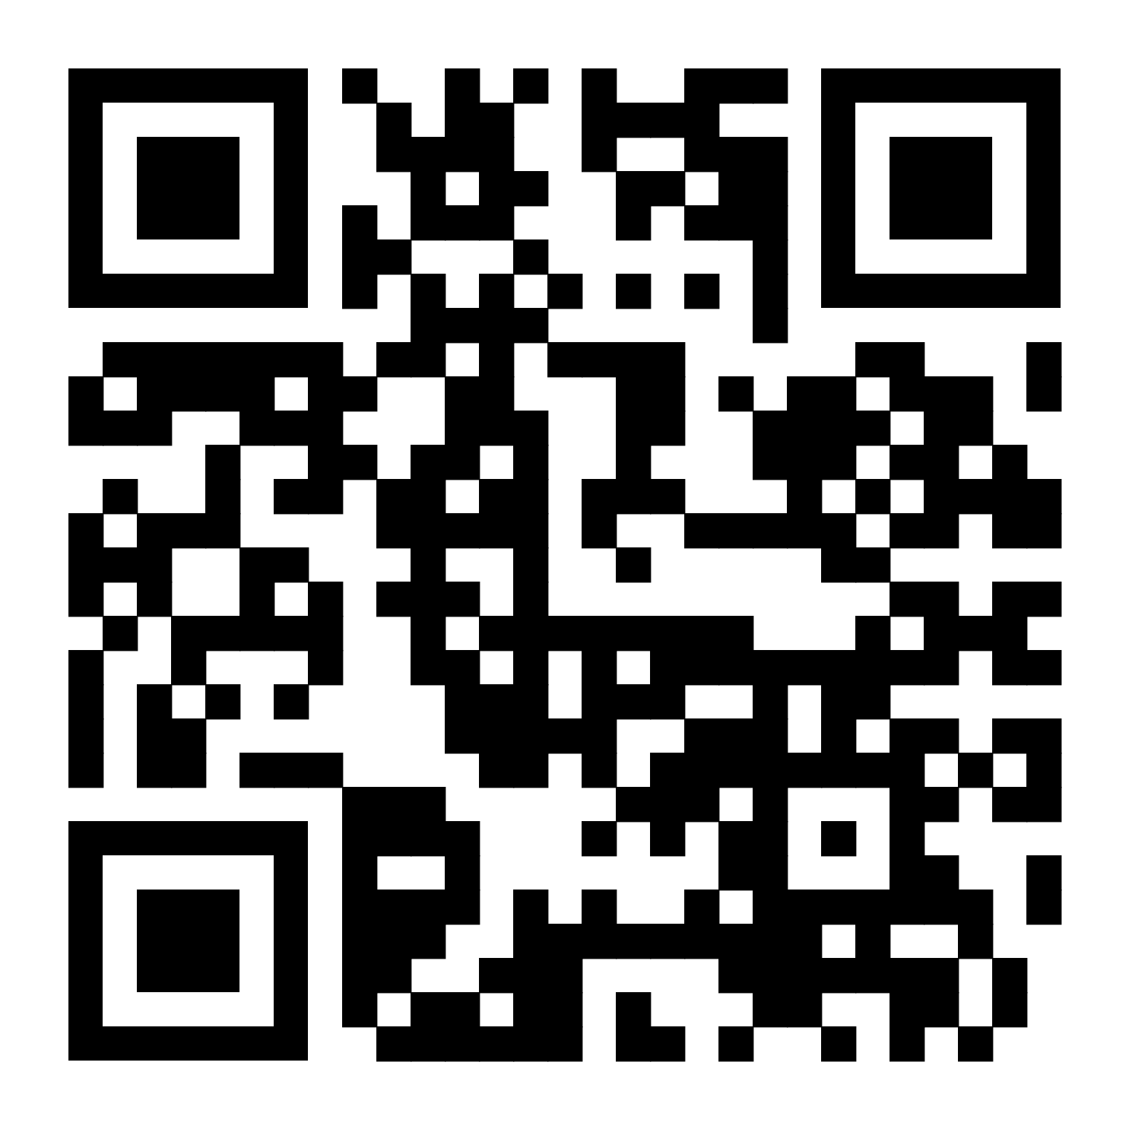
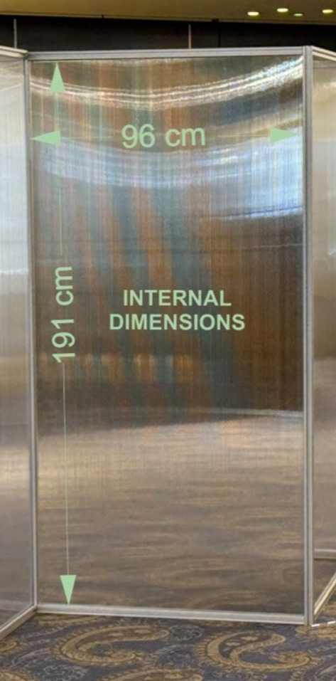
Title line 1
Title line 2
Title line 3
Authors
Affiliations
Logos Here
Poster boards are 191 cm tall and 96 cm wide (internal dimensions) and the recommendation poster size is A0 (84.1 cm x 118.9 cm, portrait). The poster can be single or double column, or combinations of these.
Please try to keep the poster readable and use tables, photos, and figures to give the full picture.
You can download the HRF event logo here.
Also note that there is no onsite poster printing availability.
Bear in mind that poster boards look like this.

